Slide 1
Chapter 8: Relational Database Design

Slide 2
Chapter 8: Relational Database Design
Features of Good Relational Design
Atomic Domains and First Normal Form
Decomposition Using Functional Dependencies
Functional Dependency Theory
Algorithms for Functional Dependencies
Decomposition Using Multivalued Dependencies
More Normal Form
Database-Design Process
Modeling Temporal Data

Slide 3

E-R Diagram for a University Enterprise

Slide 4
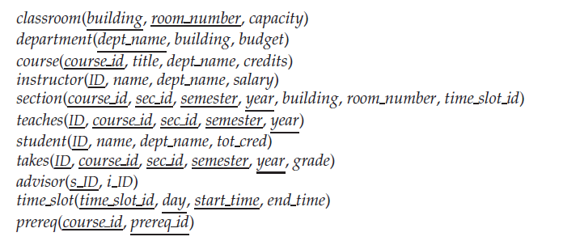
Reduce to Relational Schemas
Relational Schemas of a University Enterprise
What about combining instructor and department ?
What about combining instructor and teaches?
What about splitting student → S1(ID, department) , S2(name, tot_cred)?

Slide 5

Combine Schemas?
Suppose we combine instructor and department into inst_dept
Result is possible repetition of information
Pitfalls of the “bad” relations
  Information repetition (信息重复)
  Insertion anomalies (插入异常) 单独插入计算机系的信息插不进去
  Update difficulty (更新困难) 更新原子化的问题，比如要修改Physics的budget就需要从中找出所有Physics的instructor，然后才能修改budget

Slide 6
A Combined Schema Without Repetition
Consider combining relations
  student(id, name, tot_cred)
  stud_dept(id, deprt_name)
  ➔
  student(id, name, tot_cred, deprt_name)
No repetition in this case

Slide 7
What About Smaller Schemas?
Suppose we had started with
inst_dept(id,name,salary,dept_name, building, budget)
How would we know to split up (decompose) it into instructor and department?
if there were a schema (dept_name, building, budget),
then dept_name would be a candidate key”
Denote as a functional dependency:
id → name, salary, dept_name
dept_name → building, budget
In inst_dept, because dept_name is not a candidate key, the building and budget of a department may have to be repeated.
  This indicates the need to decompose inst_dept
Notes:
判断关系模式好不好，就看primary key能不能决定其他的属性，而这些其他属性种不能存在可以决定别的属性的属性

Slide 8
What About Smaller Schemas?
Not all decompositions are good. Suppose we decompose
employee(ID, name, street, city, salary)
→
employee1 (ID, name)
employee2 (name, street, city, salary)
The next slide shows how we lose information -- we cannot reconstruct the original employee relation -- and so, this is a lossy decomposition.

Slide 9
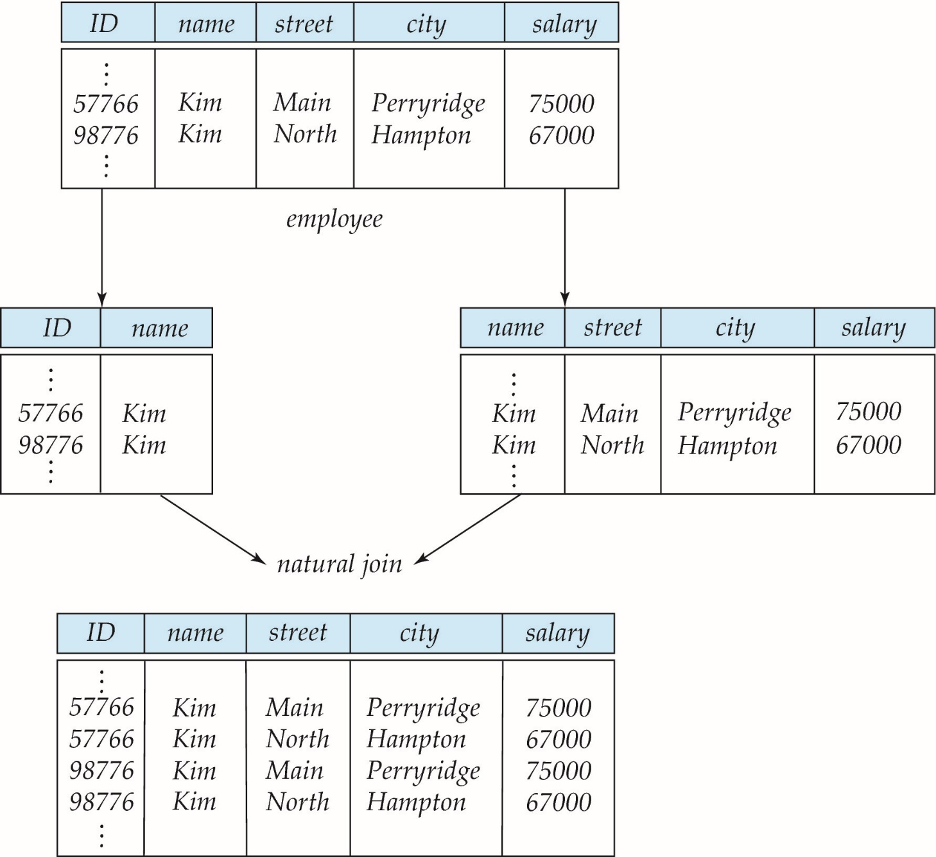
A Lossy Decomposition

Slide 10
Example of Lossless-Join Decomposition
Lossless join decomposition
Decomposition of R = (A, B, C)
R₁ = (A, B) ,R₂ = (B, C)
A
B
C
A
B
B
C
α
β
1
2
A
B
α
β
1
2
1
2
A
B
r
∏_{A,B}(r)
∏_{B,C}(r)
∏_{A} (r) ∏_{B} (r)
A
B
C
α
β
1
2
A
B
Notes:
Lossless-Join 无损连接

Slide 11
Lossless-join Decomposition
For the case of R = (R1, R2), we require that for all possible relations r on schema R
r = ∏_{R1} (r ) ∏_{R2} (r )
A decomposition of R into R1 and R2 is lossless join if and only if at least one of the following dependencies holds:
  R₁ ∩ R₂ → R₁
  R₁ ∩ R₂ → R₂
Notes:
R1和R2的公共属性要么是R1的key，要么是R2的key

Slide 12
First Normal Form———1NF
A relational schema R is in first normal form if the domains of all attributes of R are atomic.
Domain is atomic if its elements are considered to be indivisible units
  Examples of non-atomic domains:
    Set of names, composite attributes
    Identification numbers like CS101 that can be broken up into parts
Atomicity is actually a property of how the elements of the domain are used.
  Example: Strings would normally be considered indivisible
  Suppose that students are given roll numbers which are strings of the form CS0012 or EE1127
  If the first two characters are extracted to find the department, the domain of roll numbers is not atomic.
  Doing so is a bad idea: leads to encoding of information in application program rather than in the database.
Notes:
Normal Form 范式

Slide 13
Goal — Devise a Theory for the Following
Decide whether a particular relation R is in “good” form.
In the case that a relation R is not in “good” form, decompose it into a set of relations {R1, R2, ..., Rn} such that
  each relation is in good form
  the decomposition is a lossless-join decomposition
Our theory is based on:
  functional dependencies
  multivalued dependencies

Slide 14
Functional Dependencies

Slide 15
Functional Dependencies
Constraints on the set of legal relations.
Require that the value for a certain set of attributes determines uniquely the value for another set of attributes.
A functional dependency is a generalization of the notion of a key.

Slide 16
Functional Dependencies (Cont.)
Let R be a relation schema
α ⊆ R and β ⊆ R
The functional dependency
α → β
holds on R if and only if for any legal relations r(R), whenever any two tuples t₁ and t₂ of r agree on the attributes α 如果t1和t2在α上相同, they also agree on the attributes β. That is,
t₁[α] = t₂ [α] ⇒ t₁[β ] = t₂ [β ]
和函数类似，每个x有唯一的y对应
Example: Consider r(A,B ) with the following instance of r.
On this instance, A → B does NOT hold, but B → A does hold.
4
1 5
3 7
Notes:
α和β是属性的集合
不能通过单独的instance来说明函数依赖成立，当然不成立是可以通过instance推断出来

Slide 17
Functional Dependencies (Cont.)
K is a superkey for relation schema R if and only if K → R
K is a candidate key for R if and only if
  K → R, and
  for no α ⊂ K, α → R 没有k的一个真子集，使得α能够决定R，也就是说K没有多余的属性
Functional dependencies allow us to express constraints that cannot be expressed using superkeys. Consider the schema:
inst_dept (ID, name, salary, dept_name, building, budget ).
We expect these functional dependencies to hold:
dept_name→ building
and ID → building
but would not expect the following to hold:
dept_name → salary

Slide 18
Functional Dependencies (Cont.)
A functional dependency is trivial 平凡的 if it is satisfied by all instances of a relation
  Example:
    ID, name → ID
    name → name
  In general, α → β is trivial if β ⊆ α
Notes:
平凡的函数依赖

Slide 19
Closure(闭包) of a Set of Functional Dependencies
Given a set F of functional dependencies, there are certain other functional dependencies that are logically implied by F.
  For example: If A → B and B → C,
  then we can infer that A → C
The set of all functional dependencies logically implied by F is the closure of F. 所有可以由F推导出来的函数依赖就是F的closure
We denote the closure of F by F+.
F⁺ is a superset of F.
F={A→B, B→C} , what is F⁺ ?
F⁺ ={A→B, B→C, A→C, AB→B, AB→C, … }

Slide 20
Closure of a Set of Functional Dependencies
We can find F+, the closure of F, by repeatedly applying
Armstrong’s Axioms:
  if β ⊆ α, then α → β (reflexivity,自反率)
  if α → β, then γ α → γ β (augmentation，增补率)
  if α → β, and β → γ, then α → γ (transitivity，传递率)
These rules are
  Sound（正确有效的） (generate only functional dependencies that actually hold), and
  Complete（完备的） (generate all functional dependencies that hold).

Slide 21
Example
R = (A, B, C, G, H, I)
F = { A → B
A → C
CG → H
CG → I
B → H}
some members of F⁺
  A → H
    by transitivity from A → B and B → H
  AG → I
    by augmenting A → C with G, to get AG → CG
    and then transitivity with CG → I
  CG → HI
    by augmenting CG → I to infer CG → CGI,
    and augmenting of CG → H to infer CGI → HI,
    and then transitivity

Slide 22
Closure of Functional Dependencies (Cont.)
Additional rules:
  If α → β holds and α → γ holds, then α → β γ holds
  (union，合并)
  If α → β γ holds, then α → β holds and α → γ holds (decomposition，分解)
  If α → β holds and γ β → δ holds, then α γ → δ holds (pseudotransitivity，伪传递)
  The above rules can be inferred from Armstrong’s axioms.

Slide 23
Exercise 1
Functional dependency α γ → β γ holds on R(α , β , γ ),
prove that α γ → β γ is equivalent with α γ → β.
Duplicated attributes can be removed from right side of a
functional dependency.
Prove:
α γ → β γ, β γ→ β ==> α γ → β
  (reflexivity)
α γ → β ==> αγ γ → β γ ==> α γ → β γ
(Augmentation)

Slide 24
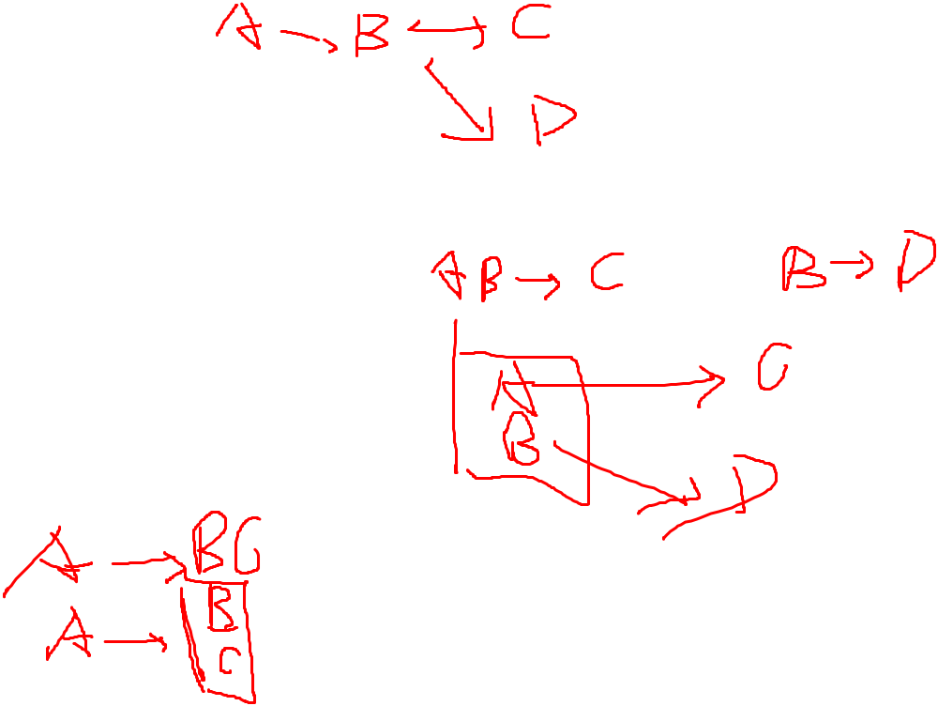
Closure of Attribute Sets
Given a set of attributes a, define the closure of a under F (denoted by a+) as the set of attributes that are functionally determined by a under F
R(A,B,C,D ) F={A→B,B→C, B→D}
  Α⁺=ABCD
  Β⁺=BCD
  C⁺=C
Algorithm to compute α⁺, the closure of α under F
result := α;
while (changes to result) do
for each β → γ in F do
begin
if β ⊆ result then result := result ∪ γ
end

Slide 25
Example of Attribute Set Closure
R = (A, B, C, G, H, I)
F = {A → B
A → C
CG → H
CG → I
B → H}
(AG)⁺
  1. result = AG
  2. result = ABCG (A → C and A → B)
  3. result = ABCGH (CG → H and CG ⊆ AGBC)
  4. result = ABCGHI (CG → I and CG ⊆ AGBCH)
Is AG a candidate key?
  Is AG a super key?
    Does AG → R? == Is (AG)⁺ ⊇ R
  Is any subset of AG a superkey?
    Does A → R? == Is (A)⁺ ⊇ R
    Does G → R? == Is (G)⁺ ⊇ R

Slide 26
Uses of Attribute Closure
There are several uses of the attribute closure algorithm:
Testing for superkey:
  To test if α is a superkey, we compute α^{+,} and check if α⁺ contains all attributes of R.
Testing functional dependencies
  To check if a functional dependency α → β holds (or, in other words, is in F⁺), just check if β ⊆ α⁺.
  That is, we compute α⁺ by using attribute closure, and then check if it contains β.
  Is a simple and cheap test, and very useful
Computing closure of F
  For each γ ⊆ R, we find the closure γ⁺, and for each S ⊆ γ⁺, we output a functional dependency γ → S.

Slide 27
Uses of Attribute Closure
Computing closure of F:
R(A,B,C), F={A→B, B→C}
computing:
A⁺=ABC, B⁺=BC, C⁺=C
(AB)⁺=ABC, (AC)⁺=ABC, (BC)⁺=BC, (ABC)⁺=ABC
F⬄{A→ABC, B→BC, C→C, AB→ABC, AC→ABC, BC→BC, ABC→ABC}
⬄{A→A, A→B,A→C, A→AB,A→AC,A→BC,A→ABC
B→B,B→C, B→BC,
C→C,
AB→A, AB→B,AB→C, AB→AB,AB→AC,AB→BC,AB→ABC,
AC→A, AC→B,AC→C, AC→AB,AC→AC,AC→BC,AC→ABC,
BC→B, BC→C, BC→BC,
ABC→A, ABC→B,ABC→C, ABC→AB, ABC→AC, ABC→BC, ABC→ABC}
=F⁺
Notes:
F的函数依赖的闭包

Slide 28
Canonical Cover（正则覆盖(最简覆盖)）
Sets of functional dependencies may have redundant dependencies that can be inferred from the others
  For example: A → C is redundant in: {A → B, B → C, A→C}
  Parts of a functional dependency may be redundant
  E.g.: on RHS: {A → B, B → C, A → CD}
    can be simplified to
    {A → B, B → C, A → D}
    .A→CD=> A→D
    .A→B,B→C => A→C , A→D =>A→CD
  E.g.: on LHS: {A → B, B → C, AC → D} can be simplified to
  {A → B, B → C, A → D}
    .A→B,B→C => A→C=> A→AC, AC→D =>A→D
    .A→D => AC→CD => AC→D
Intuitively, a canonical cover of F is a “minimal” set of functional dependencies equivalent to F, having no redundant dependencies or redundant parts of dependencies

Slide 29
Extraneous Attributes(无关属性)
Consider a set F of functional dependencies and the functional dependency α → β in F.
  Attribute A is extraneous in α if A ∈ α
  and F logically implies (F – {α → β}) ∪ {(α – A) → β}.
  Attribute A is extraneous in β if A ∈ β
  and the set of functional dependencies
  (F – {α → β}) ∪ {α →(β – A)} logically implies F.
Note: implication in the opposite direction is trivial in each of the cases above, since a “stronger” functional dependency always implies a weaker one
Example: Given F = {A → C, AB → C }
  B is extraneous in AB → C because {A → C, AB → C} logically implies A → C (I.e. the result of dropping B from AB → C).
Example: Given F = {A → C, AB → CD}
  C is extraneous in AB → CD since AB → C can be inferred even after deleting C

Slide 30
Canonical Cover
A canonical cover for F is a set of dependencies Fc such that
  F logically implies all dependencies in F_{c,} and
  F_{c} logically implies all dependencies in F, and
  No functional dependency in F_{c} contains an extraneous attribute, and
  Each left side of functional dependency in F_{c} is unique.
To compute a canonical cover for F:
repeat
Use the union rule to replace any dependencies in F
α₁ → β₁ and α₁ → β₂ with α₁ → β₁ β₂
Find a functional dependency α → β with an
extraneous attribute either in α or in β
If an extraneous attribute is found, delete it from α → β
until F does not change
Note: Union rule may become applicable after some extraneous attributes have been deleted, so it has to be re-applied

Slide 31
Computing a Canonical Cover
R = (A, B, C)
F = {A → BC
B → C
A → B
AB → C}
Combine A → BC and A → B into A → BC
  Set is now {A → BC, B → C, AB → C}
A is extraneous in AB → C
  Check if the result of deleting A from AB → C is implied by the other dependencies
    Yes: in fact, B → C is already present!
  Set is now {A → BC, B → C}
C is extraneous in A → BC
  Check if A → C is logically implied by A → B and the other dependencies
    Yes: using transitivity on A → B and B → C.
      Can use attribute closure of A in more complex cases
The canonical cover is: { A → B
B → C }

Slide 32
Computing a Canonical Cover
R = (A, B, C)
F = {A → BC
B → C
A → B
AB → C}
The canonical cover is: {A → B， B → C}
A
B
C

Slide 33
Exercise 2
For the relation schema R(A,B,C,D,E) with the functional dependencies set F={A→BC, AD→E , B→C, D→E}.
  Compute the canonical cover Fc.
  Compute (AE)⁺
  Find all candidate keys of R
  Answers
  Fc={A→B, B→C, D→E}.
  (AE)⁺ =ABCE
  Candaidate key: AD
A
B
C
D
E
Notes:
A->BC就不是一个BCNF，因为A就不是一个完整的key

Slide 34
Boyce-Codd Normal Form
A relation schema R is in BCNF with respect to a set F of functional dependencies if for all functional dependencies in F+ of the form
α→ β
where α ⊆ R and β ⊆ R, at least one of the following holds:
α → β is trivial (i.e., β ⊆ α)
α is a superkey for R
Example schema not in BCNF:
instr_dept (ID, name, salary, dept_name, building, budget )
because dept_name→ building, budget
holds on instr_dept, but dept_name is not a superkey
Notes:
F的闭包的所有的函数依赖，要么是平凡的，要么α是R的superkey
只要不是BCNF的关系模式一定存在信息冗余，更新困难，插入。。 等问题

Slide 35
Decomposing a Schema into BCNF
Suppose we have a schema R and a non-trivial dependency α→β causes a violation of BCNF.
We decompose R into:
  (αU β )
  ( R - ( β - α ) ) 去掉β，留下alpha是为了保证无损连接
In our example,
  α = dept_name
  β = building, budget
  and inst_dept is replaced by
  (α U β ) = ( dept_name, building, budget )
  ( R - ( β - α ) ) = ( ID, name, salary, dept_name )

Slide 36
BCNF Decomposition Algorithm
1 result := {R };
2 done := false;
3 compute F ⁺; // not necessary
4 while (not done) do
5 if (there is a schema R_{i} in result that is not in BCNF)
6 then begin
7 let α→ β be a nontrivial functional dependency that
8 holds on R_{i} such that α→ R_{i} is not in F ⁺, // α is not key of R_{i}
9 and α ∩ β = ∅;
10 result := (result – R_{i} ) ∪ (R_{i} – β) ∪ (α, β );
11 end
12 else done := true;
Note: each R_{i} is in BCNF, and decomposition is lossless-join.

Slide 37
Exercise 3
For the relation schema R(A,B,C,D) with the functional dependencies set F={A→B, B→CD},
  List all candidate keys of the relation.
  Decompose the relation into a collection of BCNF relations. The decomposition must be lossless-join.
  Answer:
  candidate keys: A
  R1=(B,C,D), R2=(A,B).
  The decomposition is lossless-join ,
  because R₁ ∩ R₂ = (B), and B is a candidate key of R1.
A
B
C
D
Notes:
按图分解，从叶子往根移动来分解

Slide 38
BCNF and Dependency Preservation
Constraints, including functional dependencies, are costly to check in practice unless they pertain to only one relation
If it is sufficient to test only those dependencies on each individual relation of a decomposition in order to ensure that all functional dependencies hold, then that decomposition is dependency preserving(保持依赖).
（如果检验各单个关系上的函数依赖，就能确保所有的函数依赖成立，
那么这样的分解就是依赖保持的）
（或者，原来关系R上的每一个函数依赖，都可以在分解后的单个的关
系上得到检验，或者推导出来。）
Because it is not always possible to achieve both BCNF and dependency preservation, we consider a weaker normal form, known as third normal form.

Slide 39
Example
R = (A, B, C )
F = {A → B
B → C}
Key = {A}
R is not in BCNF
Decomposition R₁ = (A, B), R₂ = (B, C)
  R₁ and R₂ in BCNF, F₁={A → B }, F₂= {B → C}
  Lossless-join decomposition
  Dependency preserving
Decomposition R₁= (A, B), R₂= (A, C)
  R₁ and R₂ in BCNF，F₁={A → B }, F₂= {A→ C}
  Lossless-join decomposition
  It is not dependency preserving, because checking B → C needs on R₁ R₂
Notes:
前面的那个算法能保证BCNF，但不能确保依赖保持

Slide 40
Dependency Preservation
Let F_{i} be the set of dependencies F ⁺ that include only attributes in R_{i}. (F_{i :} the restriction of F on Ri )
    A decomposition is dependency preserving, if
    (F₁ ∪ F₂ ∪ … ∪ F_{n} )⁺ = F ⁺
    If it is not, then checking updates for violation of functional dependencies may require computing joins, which is expensive.
Notes:
Fi是分解后的关系

Slide 41
Exercise 4
For the relation schema R(A,B,C,D,E) with the functional dependencies set F={A→B, B→CD, E→D },
  List all candidate keys of the relation.
  Decompose the relation into a collection of BCNF relations. The decomposition must be lossless-join.
  Whether the decomposition of (b) is dependency preserving or not?
  Answer:
  candidate keys: AE
  R1(E,D), R2(B,C), R3(A,B), R4(A,E)
  Above decomposition is not dependency preserving, because B→D cannot be inferred by all functional dependencies holds on R1, R2, R3, and R4.
  F1=(E→D} F2={B→C} F3={A→B} F4={AE→AE}
A
B
C
D
E

Slide 42
Exercise 4
For the relation schema R(A,B,C,D,E) with the functional dependencies set F={A→B, B→CD, E→D },
  List all candidate keys of the relation.
  Decompose the relation into a collection of BCNF relations. The decomposition must be lossless-join.
  Whether the decomposition of (b) is dependency preserving or not?
  Another Answer:
  candidate keys: AE
  R1(B,C,D), R2(A,B), R3(A,E)
  Above decomposition is not dependency preserving, because E→D cannot be inferred by all functional dependencies holds on R1, R2, R3.
  F1=(B→CD} F2={A→B} F3={AE→AE}
A
B
C
D
E

Slide 43
BCNF and Dependency Preservation
It is not always possible to get a BCNF decomposition that is dependency preserving
  R = (J, K, L )
  F = {JK → L
  L → K }
  Two candidate keys = JK and JL
  R is not in BCNF
  Any decomposition of R will fail to preserve
JK → L
This implies that testing for JK → L requires a join
J
K
L

Slide 44
Third Normal Form: Motivation
There are some situations where
  BCNF is not dependency preserving, and
  efficient checking for FD violation on updates is important
Solution: define a weaker normal form, called Third Normal Form (3NF)
  Allows some redundancy
  But functional dependencies can be checked on individual relations without computing a join.
  There is always a lossless-join, dependency-preserving decomposition into 3NF.

Slide 45
Third Normal Form
A relation schema R is in third normal form (3NF) if for all:
α → β in F⁺
at least one of the following holds:
  α → β is trivial (i.e., β ∈ α)
  α is a superkey for R
  Each attribute A in β – α is contained in a candidate key for R.
  (NOTE: each attribute may be in a different candidate key)
If a relation is in BCNF it is in 3NF (since in BCNF one of the first two conditions above must hold).
Third condition is a minimal relaxation of BCNF to ensure dependency preservation (will see why later).
Notes:
β的所有不属于α的非平凡属性都包含在一个candidate key

Slide 46
3NF Example
Relation dept_advisor:
  dept_advisor (s_ID, i_ID, dept_name)
  F = {s_ID, dept_name → i_ID, i_ID → dept_name}
  Two candidate keys: s_ID, dept_name, and i_ID, s_ID
  dept_advisor is in 3NF
    s_ID, dept_name → i_ID
      s_ID, dept_name is a superkey
    i_ID → dept_name
      dept_name is contained in a candidate key

Slide 47
Redundancy in 3NF
There is some redundancy in this schema
Example of problems due to redundancy in 3NF
  R = (J, K, L)
  F = {JK → L, L → K }
J
L
K
j₁
j₂
j₃
null
l₁
l₁
l₁
l₂
k₁
k₁
k₁
k₂
repetition of information (e.g., the relationship l₁, k₁)
  (i_ID, dept_name)
need to use null values (e.g., to represent the relationship
l₂, k₂ where there is no corresponding value for J).
  (i_ID, dept_nameI) if there is no separate relation mapping instructors to departments

Slide 48
3NF Decomposition Algorithm
1 Let F_{c} be a canonical cover for F;
2 i := 0;
3 for each functional dependency α → β in F_{c} do
4 begin
5 i := i + 1; R_{i} := α β
6 end
7 if none of the schemas R_{j}, 1 ≤ j ≤ i contains a candidate key for R
8 then begin
9 i := i + 1;
10 R_{i} := any candidate key for R;
11 end
12 /* Optionally, remove redundant relations */
13 repeat
14 if any schema R_{j} is contained in another schema R_{k}
₁₅ then /* delete R_{j} */
16 begin
17 R_{j} = R_{i} ; i=i-1;
18 until no more Rj s can be deleted
19 return (R₁, R₂, ..., R_{i})

Slide 49
Comparison of BCNF and 3NF
It is always possible to decompose a relation into a set of relations that are in 3NF such that:
  the decomposition is lossless
  the dependencies are preserved
It is always possible to decompose a relation into a set of relations that are in BCNF such that:
  the decomposition is lossless
  it may not be possible to preserve dependencies.

Slide 50
Goals of Normalization
Let R be a relation scheme with a set F of functional dependencies. Decide whether a relation scheme R is in “good” form.
In the case that a relation scheme R is not in “good” form, decompose it into a set of relation scheme {R₁, R₂, ..., R_{n}} such that
  each relation scheme is in good form (i.e., BCNF or 3NF)
  the decomposition is a lossless-join decomposition
  Preferably, the decomposition should be dependency preserving.

Slide 51
E-R Modeling and Normal Forms
Above is an E-R diagram that depicts a many-to-many relationship R between two entity sets E1 and E2. The candidate key of E1 and E2 are underlined in the diagram. If the E-R diagram is transform to a relation schema S(A, B, C, D, E, G).
Please answer following questions:
  Give the no-trivial functional dependency set F that holds on S.
  List the candidate key(s) of S.
  Prove that S is not in BCNF.
  Explain the issues exist with S.
  Prove that decomposing of S into three relation schemas R1(A,B,C), R2(D,E) and R3(A,D,G) is lossless join.
E1
G
E2
A
B
C
R
D
E

Slide 52
E-R Modeling and Normal Forms
E1
G
Please answer following questions:
  Give the no-trivial functional dependency set F that holds on S.
  F={A→BC, D→E, AD→G}
  List the candidate key(s) of S.
  AD
  Prove that S is not in BCNF.
  A→BC, A is not a key.
  Explain the issues exist with S.
  Information repetition, Insertion anomalies, Update difficulty
  Prove that decomposing of S into three relation schemas R=R1(A,B,C) (R2(D,E) R3(A,D,G))
E2
A
B
C
R
D
E
Notes:
证明无损 只要找出一个自然连接的顺序即可，也就是上面的自然连接的式子

Slide 53
How good is BCNF?
There are database schemas in BCNF that do not seem to be sufficiently normalized
Consider a relation
inst_info (ID, child_name, phone)
  where an instructor may have more than one phone and can have multiple children
ID
child_name
phone
99999
99999
99999
99999
David
David
William
Willian
512-555-1234
512-555-4321
512-555-1234
512-555-4321
inst_info
Notes:
BCNF在某些情况下存在明显的冗余
BCNF不可能有函数依赖，但是可能存在多值依赖
BCNF的冗余是因为在一个关系中存在多个多值

Slide 54
How good is BCNF? (Cont.)
There are no non-trivial functional dependencies and therefore the relation is in BCNF
Insertion anomalies – i.e., if we add a phone 981-992-3443 to 99999, we need to add two tuples
(99999, David, 981-992-3443)
(99999, William, 981-992-3443)

Slide 55
How good is BCNF? (Cont.)
Therefore, it is better to decompose inst_info into:
ID
child_name
inst_child
99999
99999
99999
99999
David
David
William
Willian
ID
phone
inst_phone
99999
99999
99999
99999
512-555-1234
512-555-4321
512-555-1234
512-555-4321
This suggests the need for higher normal forms, such as Fourth Normal Form (4NF).

Slide 56
Multivalued Dependencies

Slide 57
Multivalued Dependencies
Suppose we record names of children, and phone numbers for instructors:
  inst_child(ID, child_name)
  inst_phone(ID, phone_number)
If we were to combine these schemas to get
  inst_info(ID, child_name, phone_number)
  Example data:
  (99999, David, 512-555-1234)
  (99999, David, 512-555-4321)
  (99999, William, 512-555-1234)
  (99999, William, 512-555-4321)
This relation is in BCNF
  Why?

Slide 58
Multivalued Dependencies (MVDs)
Let R be a relation schema and let α ⊆ R and β ⊆ R. The multivalued dependency
α →→ β
holds on R if in any legal relation r(R), for all pairs for tuples t₁ and t₂ in r such that t₁[α] = t₂ [α], there exist tuples t₃ and t₄ in r such that:
t₃ [α] = t₄ [α]= t₁[α] = t₂ [α]
t₃[β] = t₁ [β]
t₃[R – β] = t₂[R – β]
t₄ [β] = t₂[β]
t₄[R – β] = t₁[R – β]
Notes:
多值依赖
通俗理解： 将一个元组属性分为X，Y，Z，如果X多值决定Y，则仅根据X和Z，无法找出Y,因此也就是说X相对于不同Y的所有可能的Z值都相同

Slide 59

MVD (Cont.)
Tabular representation of α →→ β
Notes:
如果α多指决定β，它也多指决定

Slide 60
Example
Let R be a relation schema with a set of attributes that are partitioned into 3 nonempty subsets.
Y, Z, W
We say that Y →→ Z (Y multidetermines Z )
if and only if for all possible relations r (R )
< y1, z1, w1 > ∈ r and < y1, z2, w2 > ∈ r
then
< y₁, z₁, w₂ > ∈ r and < y₁, z₂, w₁ > ∈ r
Note that since the behavior of Z and W are identical it follows that
Y →→ Z if Y →→ W

Slide 61
Example (Cont.)
In our example:
ID →→ child_name
ID →→ phone_number
The above formal definition is supposed to formalize the notion that given a particular value of Y (ID) it has associated with it a set of values of Z (child_name) and a set of values of W (phone_number), and these two sets are in some sense independent of each other.
Note:
  If Y → Z then Y →→ Z
  Indeed we have (in above notation) Z₁ = Z₂

Slide 62
Theory of MVDs
From the definition of multivalued dependency, we can derive the following rule:
  If α → β, then α →→ β
That is, every functional dependency is also a multivalued dependency
The closure D+ of D is the set of all functional and multivalued dependencies logically implied by D.

Slide 63
Fourth Normal Form
A relation schema R is in 4NF with respect to a set D of functional and multivalued dependencies if for all multivalued dependencies in D⁺ of the form α →→ β, where α ⊆ R and β ⊆ R, at least one of the following hold:
  α →→ β is trivial (i.e., β ⊆ α or α ∪ β = R)
  α is a superkey for schema R
If a relation is in 4NF it is in BCNF

Slide 64
4NF Decomposition Algorithm
result: = {R};
done := false;
compute D⁺;
Let D_{i} denote the restriction of D⁺ to R_{i}
while (not done)
if (there is a schema R_{i} in result that is not in 4NF) then
begin
let α →→ β be a nontrivial multivalued dependency that holds
on R_{i} such that α → R_{i} is not in D_{i}, and α∩β=φ;
result := (result - R_{i}) ∪ (R_{i} - β) ∪ (α, β);
end
else done:= true;
Note: each R_{i} is in 4NF, and decomposition is lossless-join

Slide 65
Example
R =(A, B, C, G, H, I)
F ={ A →→ B
B →→ HI
CG →→ H }
R is not in 4NF since A →→ B and A is not a superkey for R
Decomposition
a) R₁ = (A, B) (R₁ is in 4NF)
b) R₂ = (A, C, G, H, I) (R₂ is not in 4NF, decompose into R₃ and R₄)
c) R₃ = (C, G, H) (R₃ is in 4NF)
d) R₄ = (A, C, G, I) (R₄ is not in 4NF, decompose into R₅ and R₆)
  A →→ B and B →→ HI ➔ A →→ HI, (MVD transitivity), and
  and hence A →→ I (MVD restriction to R₄)
e) R₅ = (A, I) (R₅ is in 4NF)
f)R₆ = (A, C, G) (R₆ is in 4NF)

Slide 66
E-R Modeling and Normal Forms
Above is an E-R diagram that depicts a many-to-many relationship R between two entity sets E and E’. The candidate key of E and E’ are underlined in the diagram. B and C are multivalued attributes of Entity E. If the Entity E is transform to a relation schema E(A,B,C,D).
Please answer following questions:
  Give the no-trivial functional dependency and multivalued dependency set D that holds on E.
  List the candidate key(s) of E.
  Prove that E is not in 4NF.
  Explain the issues exist with E.
  Please decompose E into 4NF relations.
E
H
E’
A
{B}
{C}
D
R
E
G

Slide 67
E-R Modeling and Normal Forms
Please answer following questions:
  Give the no-trivial functional dependency and multivalued dependency set D that holds on E.
  D = {A→D, A→→B, A→→C}
  List the candidate key(s) of E : ABC
  Prove that E is not in 4NF.
  A→→B is no-trivial , and A is not a key.
  Explain the issues exist with E.
  Information repetition, Insertion anomalies, Update difficulty
  Please decompose E into 4NF relations.
  R1（A，B），R2（A，C), R3(A, D)
E
H
E’
A
{B}
{C}
D
R
E
G

Slide 68
Overall Database Design Process
We have assumed schema R is given
  R could have been generated when converting E-R diagram to a set of tables.
  R could have been a single relation containing all attributes that are of interest (called universal relation).Normalization breaks R into smaller relations.
  R could have been the result of some ad hoc design of relations, which we then test/convert to normal form.

Slide 69
ER Model and Normalization
When an E-R diagram is carefully designed, identifying all entities correctly, the tables generated from the E-R diagram should not need further normalization.
However, in a real (imperfect) design, there can be functional dependencies from non-key attributes of an entity to other attributes of the entity
  Example: an employee entity with attributes
  department_name and building,
  and a functional dependency
  department_name→ building
  Good design would have made department an entity

Slide 70
Denormalization for Performance
May want to use non-normalized schema for performance
For example, displaying prereqs along with course_id and title requires join of course with prereq
Alternative 1: Use denormalized relation containing attributes of course as well as prereq with all above attributes
  faster lookup
  extra space and extra execution time for updates
  extra coding work for programmer and possibility of error in extra code
Alternative 2: use a materialized view defined as
course prereq
  Benefits and drawbacks same as above, except no extra coding work for programmer and avoids possible errors
Notes:
反范式

Slide 71
Other Design Issues
Some aspects of database design are not caught by normalization
Examples : 3 approaches to represent the same information:
  1. earnings (company_id, year, amount )
  2. earnings_2012(company_id, earnings)
  earnings_2013(company_id, earnings)
  earnings_2014(company_id, earnings)
    Above are in BCNF, but make querying across years difficult and needs new table each year 针对某一年的查询更高效，也不需要存储year
    有利于支持大数据的并发处理
  3. company_year (company_id, earnings_2012, earnings_2013,
  earnings_2014) 利于显示，不利于分析
    Also in BCNF, but also makes querying across years difficult and requires new attribute each year.
    Is an example of a crosstab, where values for one attribute become column names
    Used in spreadsheets, and in data analysis tools1

Slide 72
End of Chapter

